Slide 1

SAFECode
101
So you’re a SAFECode member.
Now what?

Slide 2
Have You Ever…?
…found yourself working on a problem and wondering if anyone else has already solved it?
…finished a pilot program so successful you want to share it so everyone can try it?
…been interested in giving back to the security community, but don’t know where to start?
…had an idea you think is good, but wish you had a way to troubleshoot it with your peers?
…tried to convince your leadership team to invest in a new program, but need to find a way to demonstrate that it is common industry practice?
…wanted to talk about your experiences with others in the industry, but concerned about oversharing in the age of Twitter?

Slide 3


SAFECode
Can Help!

Slide 4
What is SAFECode?
SAFECode is a global industry forum where business and technical leaders can safely and directly connect with other professionals tasked with managing highly scalable, global software security programs to exchange ideas, share lessons learned, and collaborate on ways to make a positive impact on both their businesses and the security of the greater technology ecosystem.
www.safecode.org

Slide 5










SAFECode provides an NDA-protected (aka safe and company-sanctioned) environment for you to collaborate with your software security peers at other leading technology companies.
What Does This Mean for You?

Slide 6
How Does it Work?
SAFECode offers several ways for employees of member companies to collaborate with each other.
Members-Only Portal
The best way to keep up-to-date on SAFECode activities is by joining the member portal. SAFECode uses Basecamp in a number of ways:
Hub for SAFECode news and announcements
Place for member-to-member discussion
Workspace for project teams and working groups
Monthly Member-led Brown Bag Sessions
SAFECode members can learn how member peers are tackling challenges in software and supply chain security via SAFECode’s members-only webinar series.
All sessions are one hour in length and include plenty of time for Q&A and discussion.
Members are welcome to join us live or catch up with what they missed on-demand.
Membership Meetings
SAFECode holds an annual All-Members meeting at the RSA Conference in San Francisco as well as other in-person gathering opportunities at other events as desired by members.
Working Groups
SAFECode has a number of active working groups, led by members but supported by a professional staff, on topics proposed and selected by member representatives.
Participation in working groups can be as hands-on or hands-off as you want. Members are always welcome to submit new areas of interest.

Slide 7

Why Choose SAFECode?
There are tons of opportunities to network and volunteer in cybersecurity. Why should I consider SAFECode?
Reason 5: It is safe and confidential
All information shared by members in SAFECode activities is protected under a unique NDA agreed to by all participants (including us!). Nothing you share with SAFECode members will be shared publicly without your explicit consent. You still need to follow our confidentiality guidance, but SAFECode offers additional protections that increase the depth of collaboration amongst its members.

Slide 8
Why Choose SAFECode?
There are tons of opportunities to network and volunteer in cybersecurity. Why should I consider SAFECode?
Reason 4: Professional Cat Wranglers
Ever volunteer with an .org and feel like you spend all your time wrangling cats? We know you don’t want to spend your time setting up meetings, sending out minutes or planning events. Don’t worry – SAFECode has a professional staff standing by to help you. They work hard to ensure your contribution revolves around your expertise, not your conference call wrangling, notetaking or proofreading skills.

Slide 9
Why Choose SAFECode?
There are tons of opportunities to network and volunteer in cybersecurity. Why should I consider SAFECode?
Reason 3: Your job is hard
Let’s be honest, software security isn’t easy. And even when we figure out what needs to be done, getting it done at scale is an entirely different matter. Our fellow SAFECode members are in the same boat. They represent some of the world’s largest global software companies and they know that just handing you a checklist of good things to do won’t get the job done. They know that even the smallest changes can be hard to make in the largest organizations. Find the folks who are walking in your shoes and see if you can’t work together to find a way up those hills and around those roadblocks.

Slide 10
Why Choose SAFECode?
There are tons of opportunities to network and volunteer in cybersecurity. Why should I consider SAFECode?
Reason 2: Save The World
(or at least its software!)
As a SAFECode member, we work to make a positive impact on the security of the greater technology ecosystem by sharing best practices, advocating for a thoughtful approach to global government policies affecting software security, and helping others who may just be starting on the software security journey our organization has been on for many years. We can’t do this without members of our team stepping up and sharing what they know. Consider getting involved today and leave your mark – large or small – on the mission to improve the security of the software we both create and use.

Slide 11
Why Choose SAFECode?
There are tons of opportunities to network and volunteer in cybersecurity. Why should I consider SAFECode?
Reason 1: You are Smart, Go Show Off!
We think we have one of the most innovative and smart software security teams out there. This includes you. SAFECode is an opportunity for you to build your personal profile in the industry and share your talents with others. You can contribute to published papers, blog posts and social media campaigns. You can speak at industry events on behalf of SAFECode, or host a brown bag session for other SAFECode members on that innovative program you successfully piloted. You can even lead a working group. Whether you have 1 or 100 hours to contribute, SAFECode can give you an opportunity to strut your stuff.

Slide 12

Okay, I am interested! Now what?
Email your lead SAFECode rep and let them know you are interested in joining.
Email helpdesk@safecode.org and let us know you are one of our team members and would like to get involved. We will clear it with your member reps and set you up with an account on Basecamp.
Visit safecode.org/member-information
There you will find:
• A list of upcoming events, including member brown bag sessions.
• A list of active working groups.
• Copies of recent member newsletters – a great place to get caught up on SAFECode happenings.
• A list of helpful contacts.

Slide 13
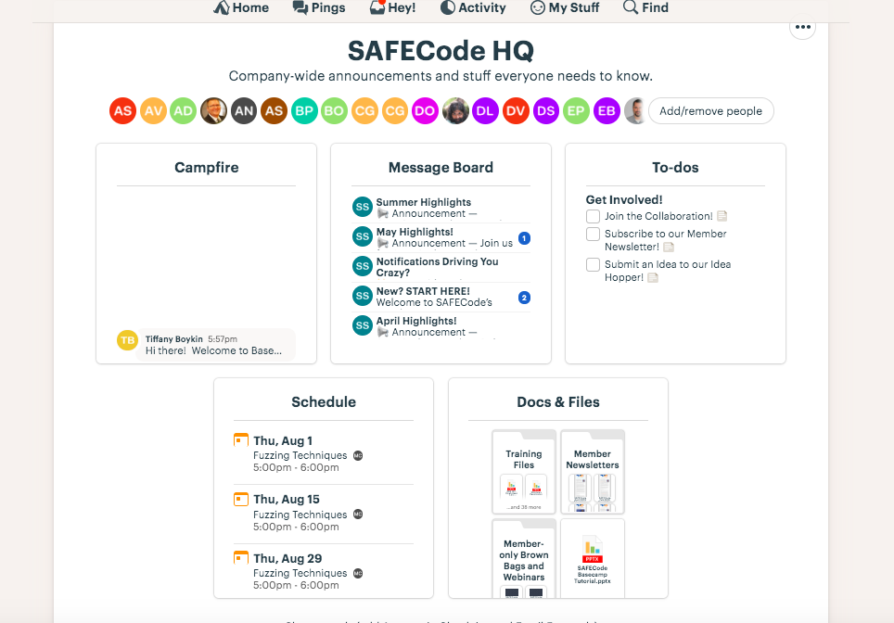
Getting Started with Basecamp
Place for a quick question or announcement (your note goes to everyone)
The Basecamp HQ is open to all members and anything you post here will be shared with everyone.
SAFECode projects and working groups maintain their own pages within Basecamp. To join them, you’ll need to email helpdesk@safecode.org.
You’ll find these areas of Basecamp to look just like HQ but be more collaborative since you are posting to a smaller group.
News every SAFECode member needs to know
Easy things you can do to get involved and follow along.
Past newsletters, webinars and other helpful resources (including a more detailed Basecamp tutorial)
Upcoming Member Events
Questions? Contact the team at helpdesk@safecode.org

Slide 14
Getting Started with Basecamp
SAFECode projects and working groups maintain their own pages within Basecamp. To join them, you’ll need to email helpdesk@safecode.org. Let us know what you are interested in seeing, and we will add it to your Basecamp page.
You’ll find these areas of Basecamp to look just like HQ but be more interactive and collaborative since you are posting to a smaller group, who have all opted-in for notifications on that topic.
In fact, if you have any questions at all, SAFECode staff is standing by to help. Use that helpdesk@safecode.org email freely. We love to hear from new members and are happy to lend a hand.

Slide 15
Questions?
Contact us at helpdesk@safecode.org

